Slide 1
Ticketmaster & Billboard API: Does Appearance on Billboard Top 100 Affect Ticket Prices?
Caterina Messina
Eco 590
Professor Kaltenberg

Slide 2
Motivation
Ticketmaster's dynamic pricing is is based on demand for an event.
It would be interesting to see to what extent this affects the price range and if it is driven by an Artists appearance on the Billboard top 100 artists.

Slide 3


Research Question
1) Does an artists appearance on the Billboard Top 100 Artists in 2021 or 2022 have an effect on their average concert ticket prices in 2023?
2) Does the Ranking on Billboard have an affect on the price range for 2023 shows?

Slide 4
Key Variables
-Price Range: Avg. ticket price range
-Rank: Billboard rank (Top 100 Artists)
-Artist: Name of artist
-Genre: Artist’s music genre

Slide 5
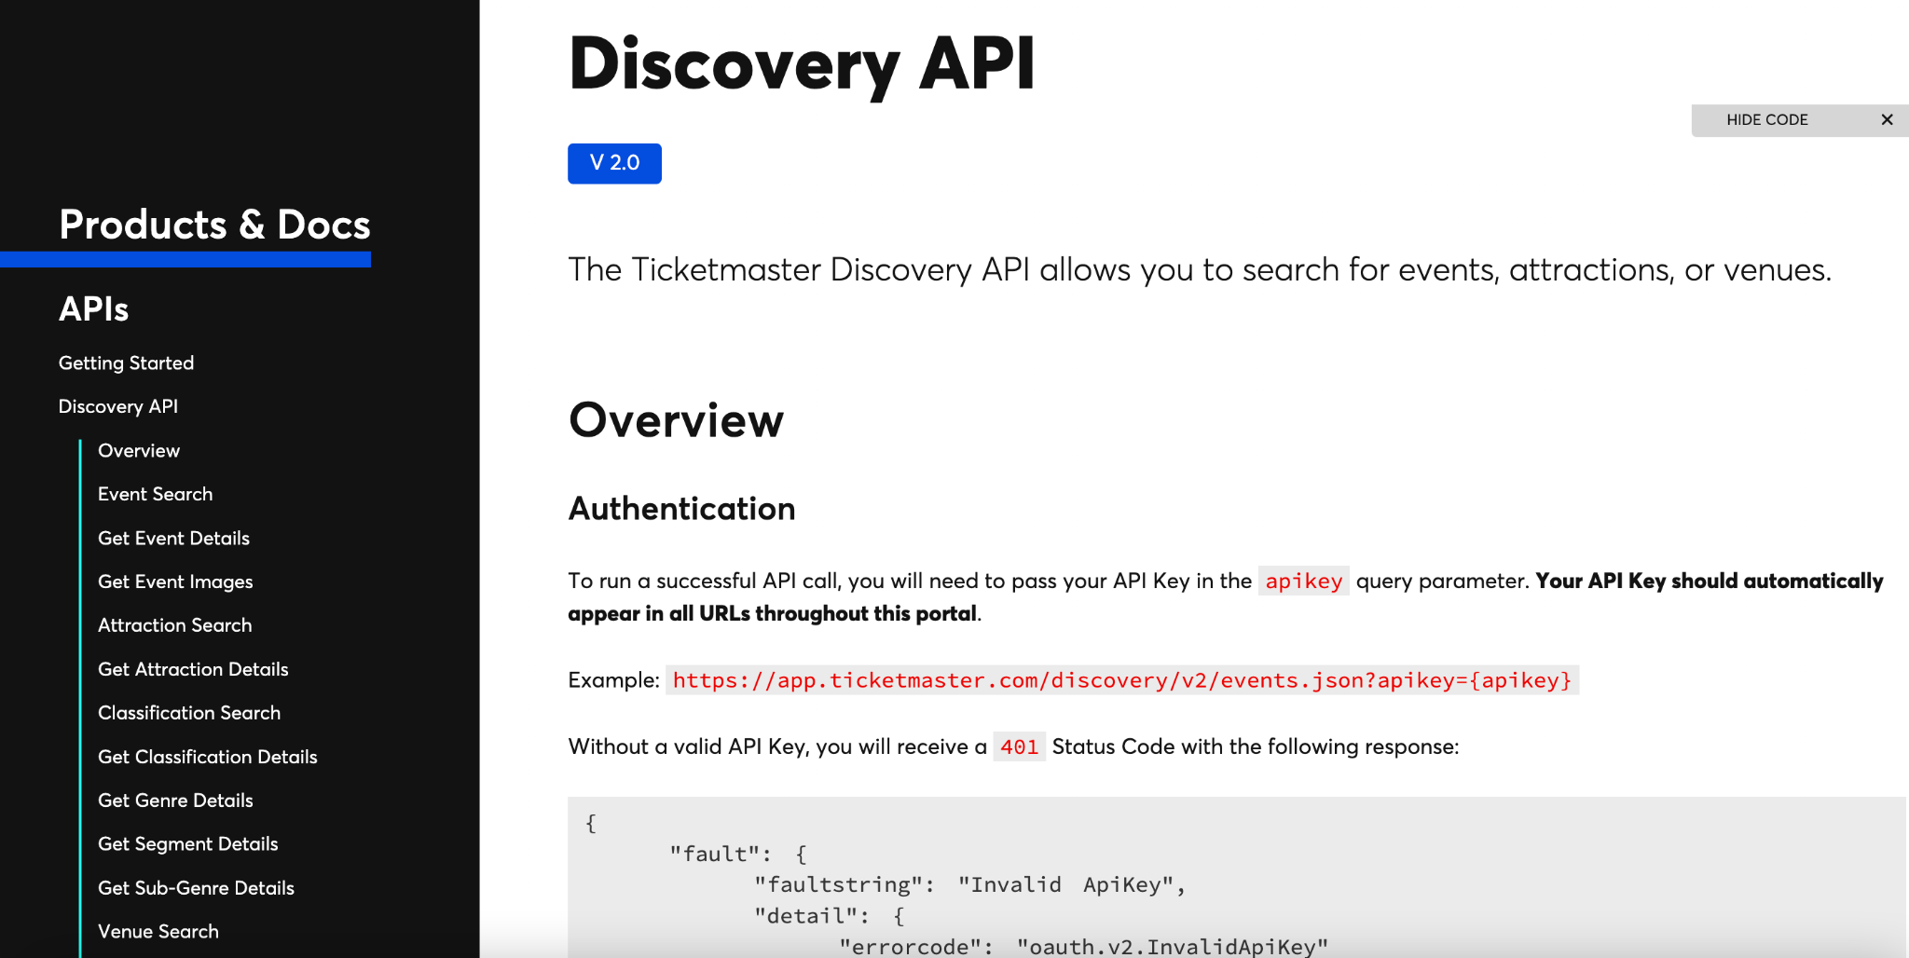
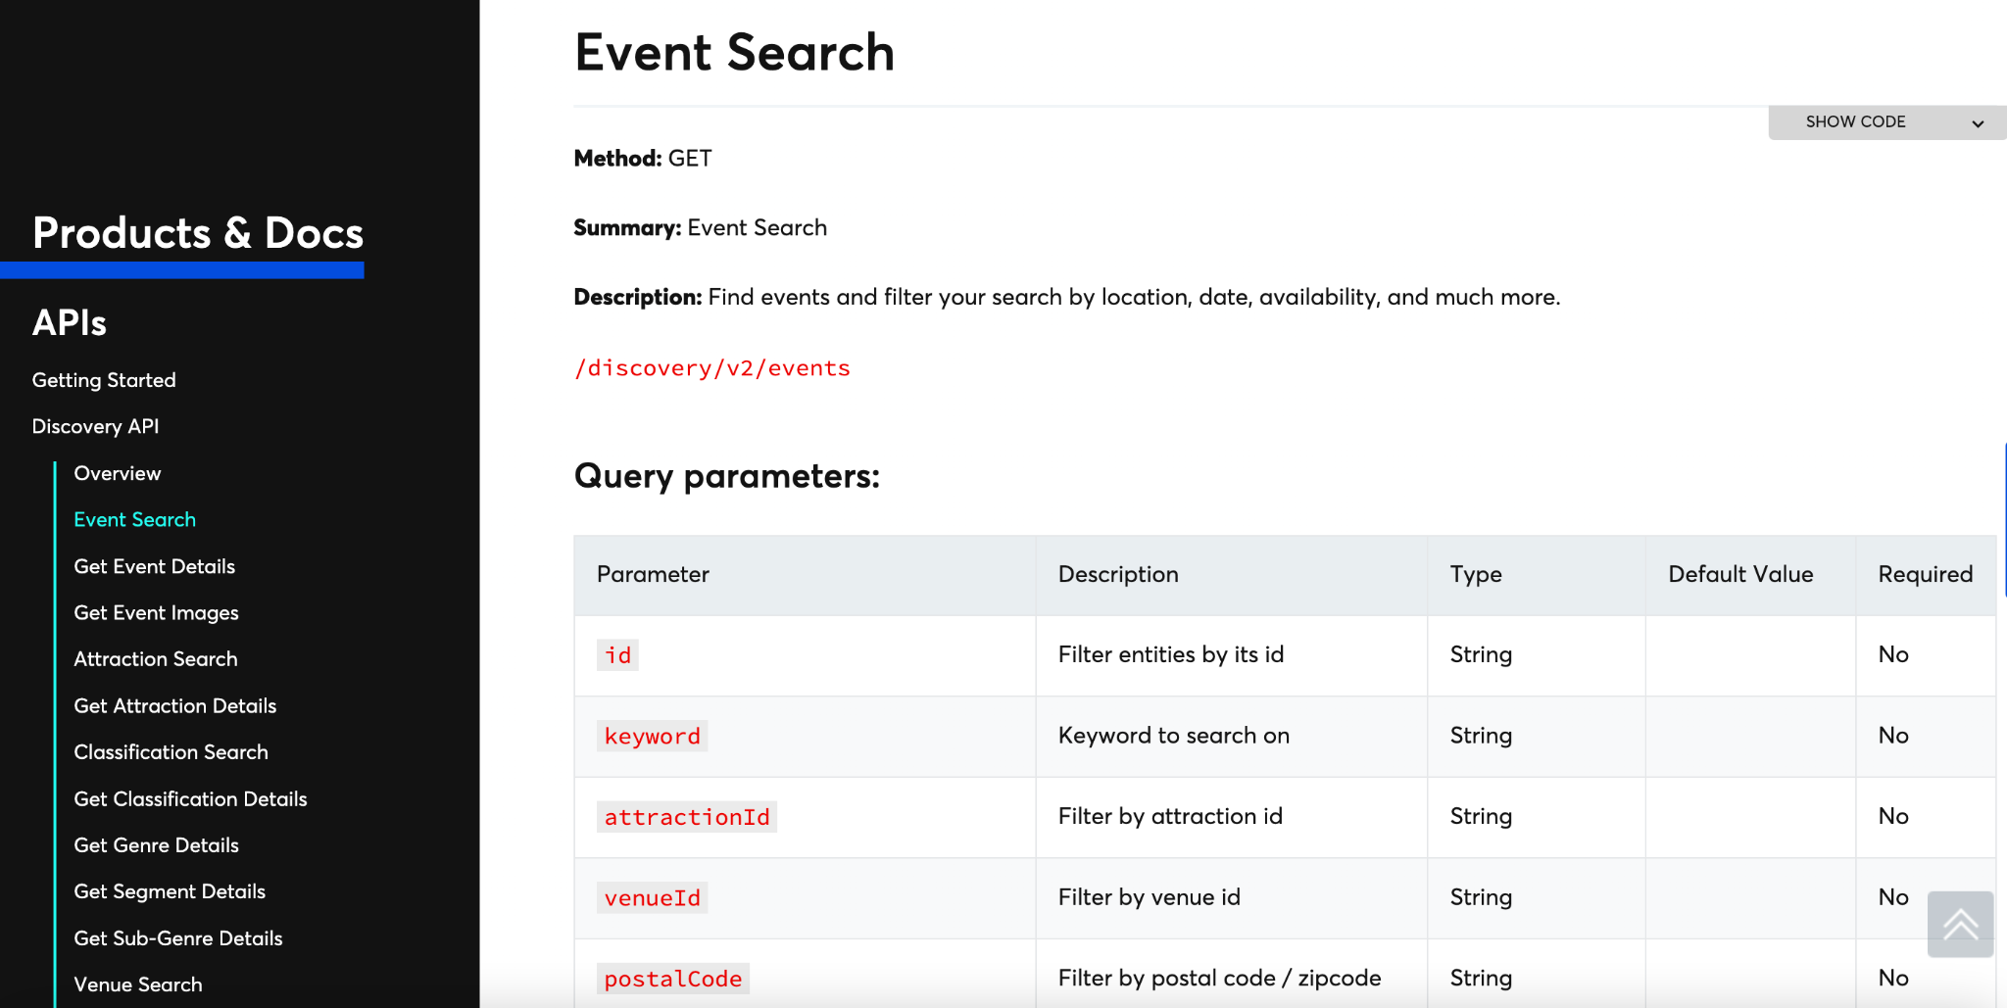
Ticketmaster’s API

Slide 6
The URL
root = 'https://app.ticketmaster.com/discovery/v2/'
url = (root + 'events.json?'
'classificationName=music'
'&countryCode=US'
'&source=Ticketmaster'
'&source=Ticketmaster%20Resale'
'&'+ apikey
)
fixed url
specifying event search
specifying music event
filtering for US only
specific sources
unique api key

Slide 7
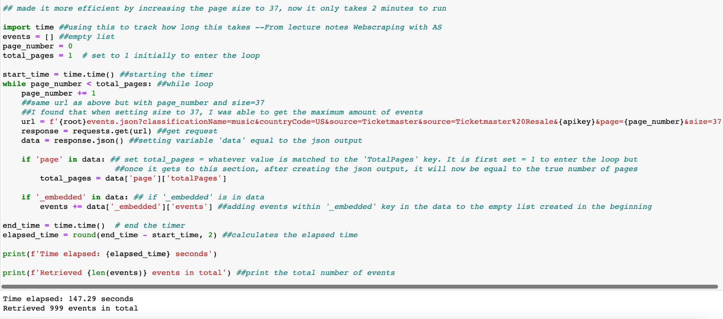
Code

Slide 8
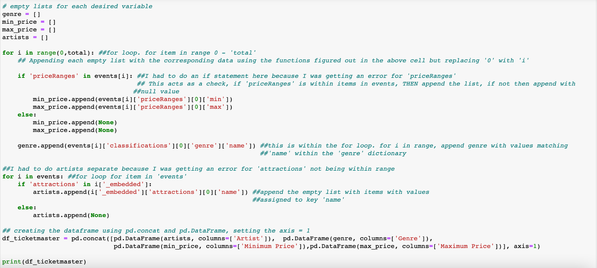
Code

Slide 9
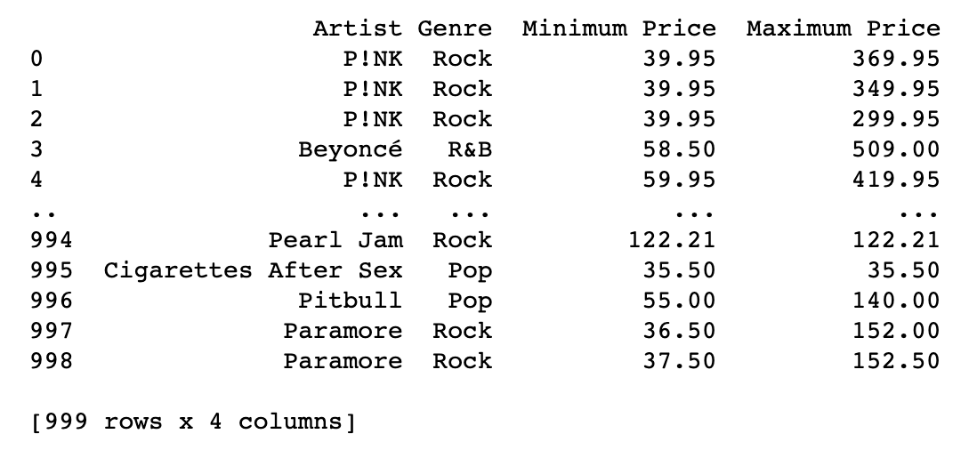
Output

Slide 10
Data Cleaning
Replacing an individual artist name to match the style on Billboard before merging
df_ticketmaster['Artist'] = df_ticketmaster['Artist'].replace(['Beyoncé'], 'Beyonce')
Grouping the data by artist & genre, collapsing to have the average prices
avg = round(df_ticketmaster[['Minimum Price', 'Maximum Price', 'Artist','Genre']].drop_duplicates().groupby(['Artist','Genre']).mean(),2).reset_index()

Slide 11
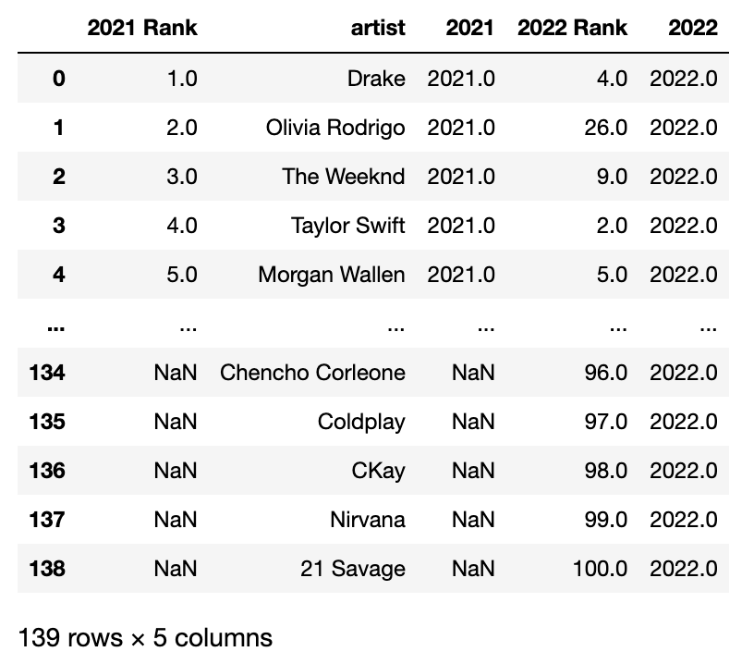
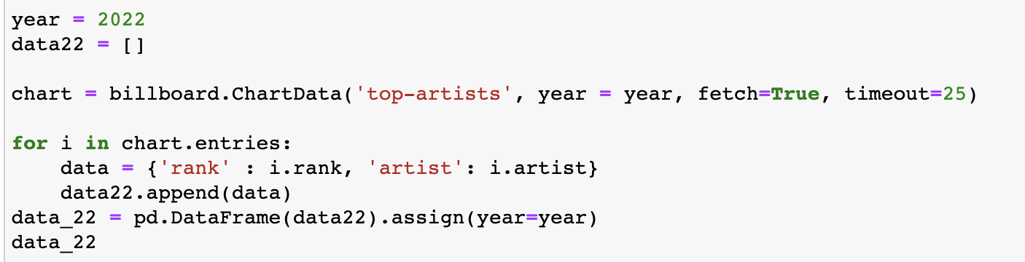
Billboard.py
pip install billboard.py
Attributes found from the Read.me in the Github for the Billboard API
Merged 2021 and 2022 data together based on artist name

Slide 12
Merging
Merging Ticketmaster and Billboard dataframes
merge = pd.merge(avg_df, df_billboard, left_on=['Artist'], right_on=['artist'],how='left')
Changed year into binary variables
newmerge['Year 2021'] = np.where(newmerge['2021'] == 2021.0, 1, 0)
Created new variable: Range
newmerge['Range'] = round(newmerge['Maximum Price'] - newmerge['Minimum Price'],2)

Slide 13
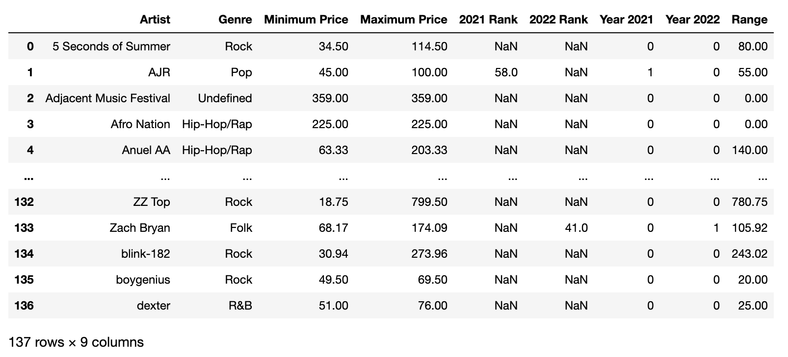
Final Dataset

Slide 14
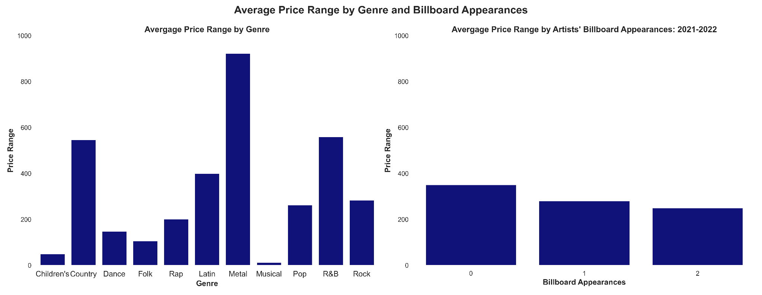
Graphs

Slide 15
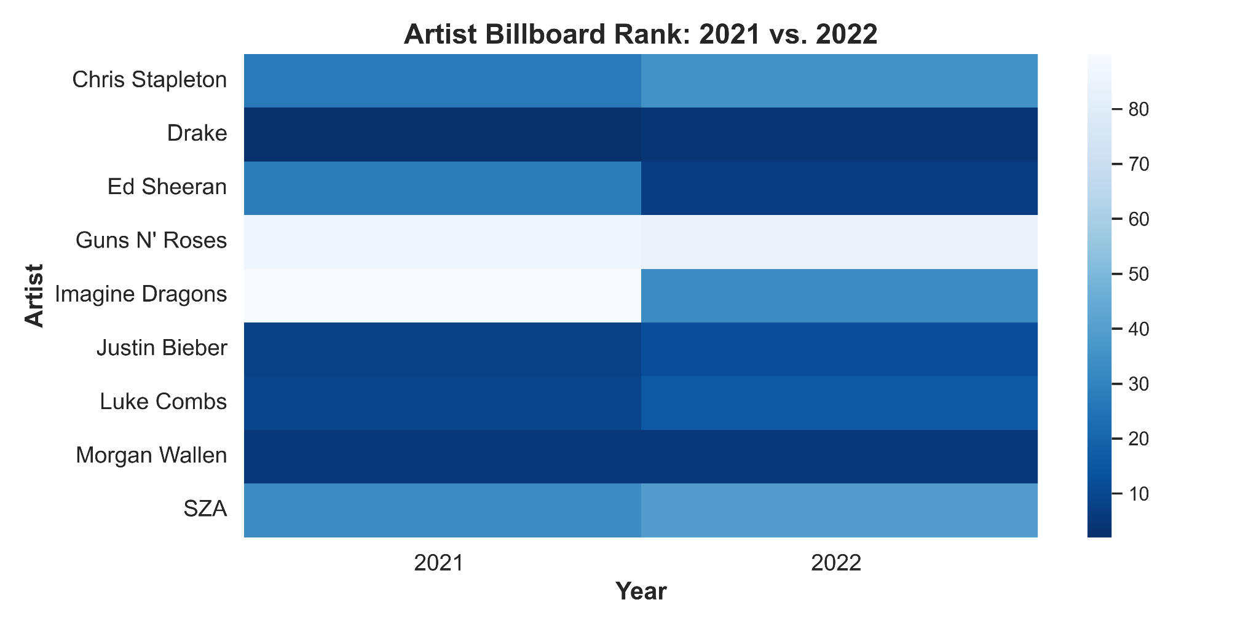
Heatmap

Slide 16
Models
Rank on log of price range
log(Range_{i}) = X2022.Rank_{i} + X2021.Rank_{i} + u_{i}
Appearance in Billboard on price range, where genre is filtered to Rock and Metal
Range_{i} = billboard_{i} + Genre_{i} + u_{i}
Appearance in Billboard on price range
Range_{i} = billboard_{i} + Genre_{i} + u_{i}

Slide 17
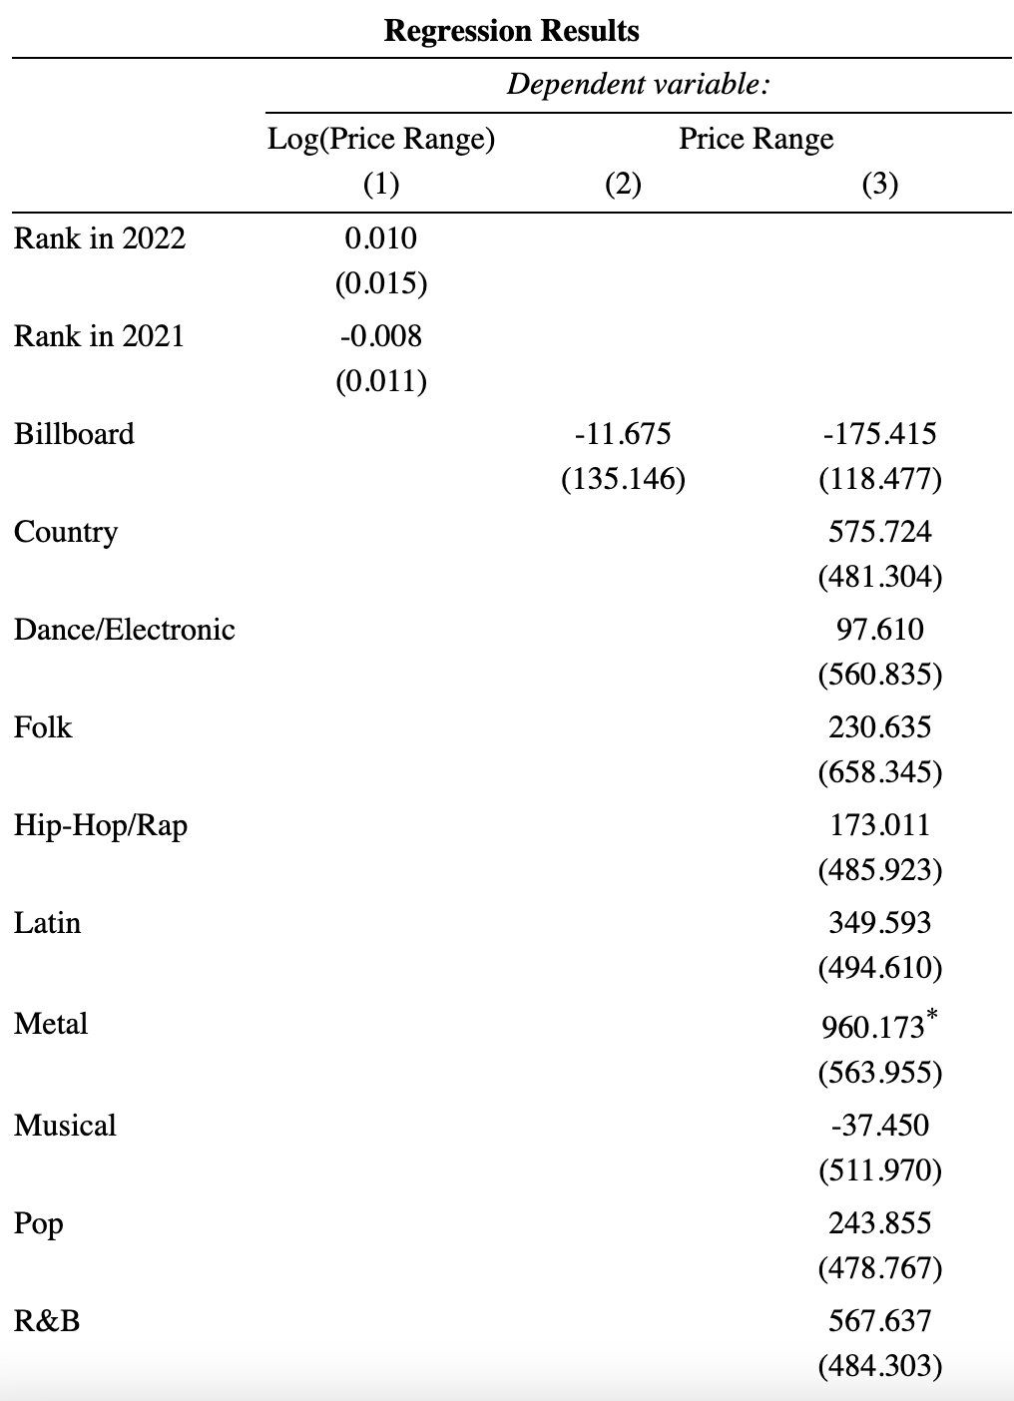

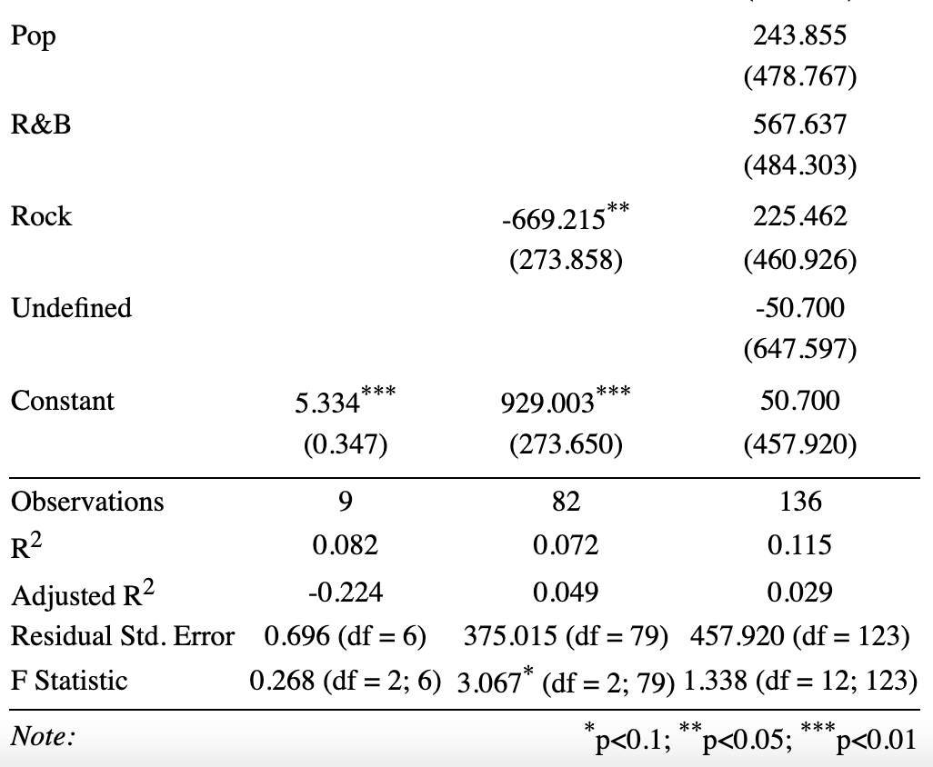

Slide 18
Discussion
Regression 1:
Shows that for each additional ranking point in 2022, the price range increases by 0.01%
Additionally, for each additional ranking point in 2021, the price range decreases by 0.008%
Regression 2:
Shows that, when only looking at artists categorized as Rock or Metal, if the artist appeared in Billboard, they have an average price range that is $11.68 lower than non-Billboard artists
Additionally, the average price range for Rock artists is $669 lower than Metal artists
Regression 3:
Shows that artists who appear on Billboard have an average price range that is $175 lower than artists who do not appear on Billboard

Slide 19
Conclusion
Results seem to be mixed as to whether Billboard appearance has a negative or positive correlation to price range. None of which are statistically significant.
More variables should be collected -- album sales, popularity, length of career, artist’s label, age, and gender
More years should be collected as well, Ticketmaster does not provide past data which makes this more complicated
Billboard Top 100 Artists may not be a good indicator of why an artist may have such a wide price range

Slide 20
Thank You!

